Slide 1

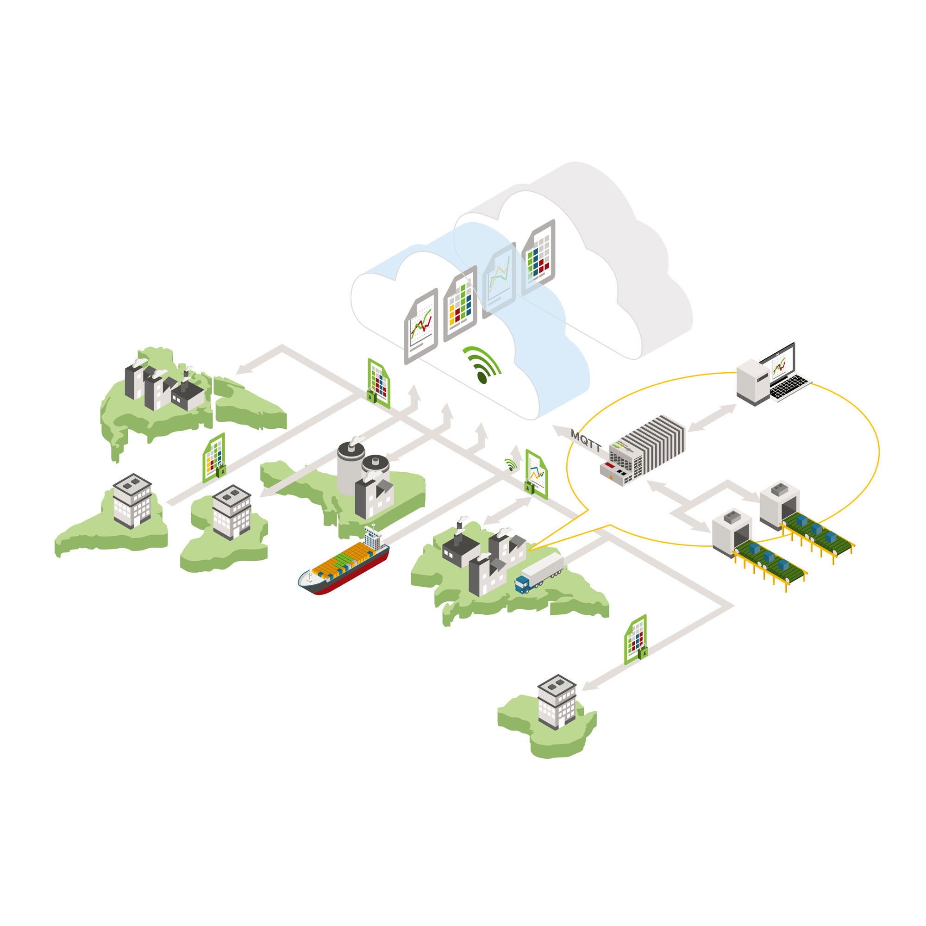


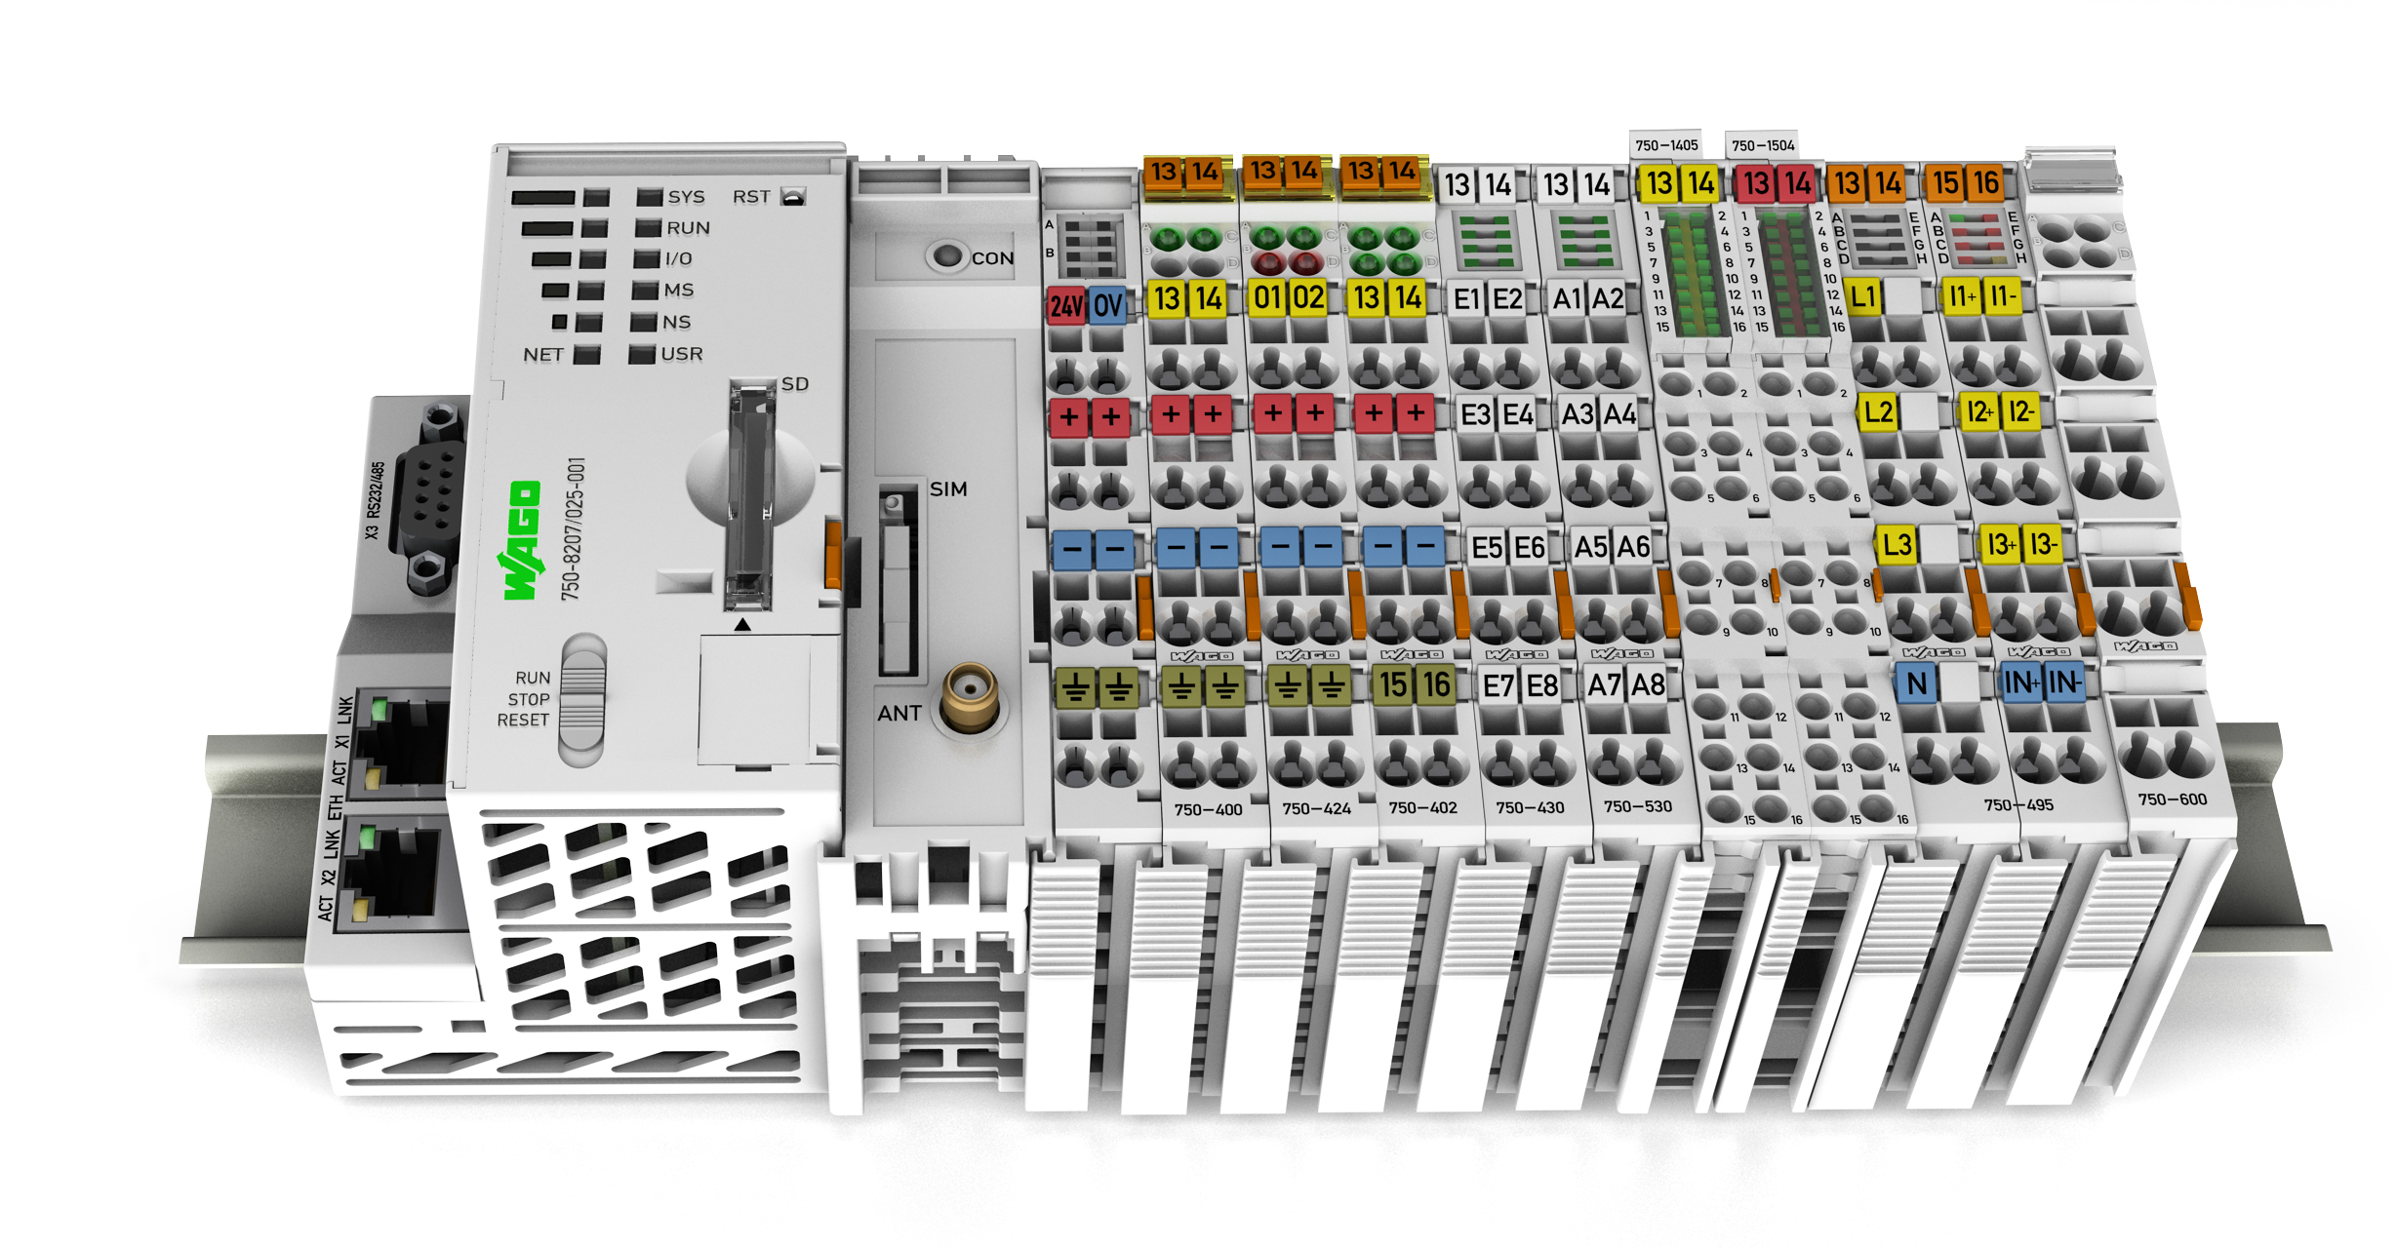
Glossary:
Ubidots Setup
Login
Create New Device
Get API Label, ID, & Token
Download PEM Certs
PFC200 Setup
Go online
WBM Cloud Connectivity
Codesys Setup
Create New Project
Add Device
Create POU and Task
Go online
The Code (MQTT Publishing)
The MQTT library
Example 1: Simple Hard-code
The JSON library
Example 2: Parameterized JSON

Slide 2
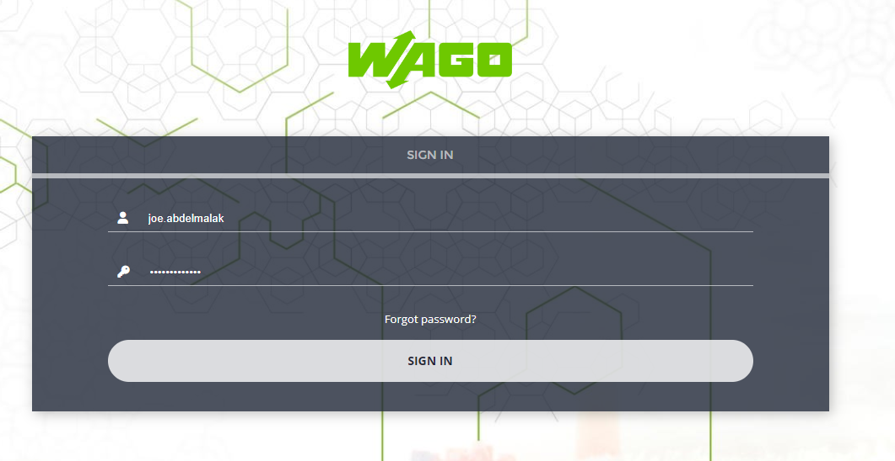
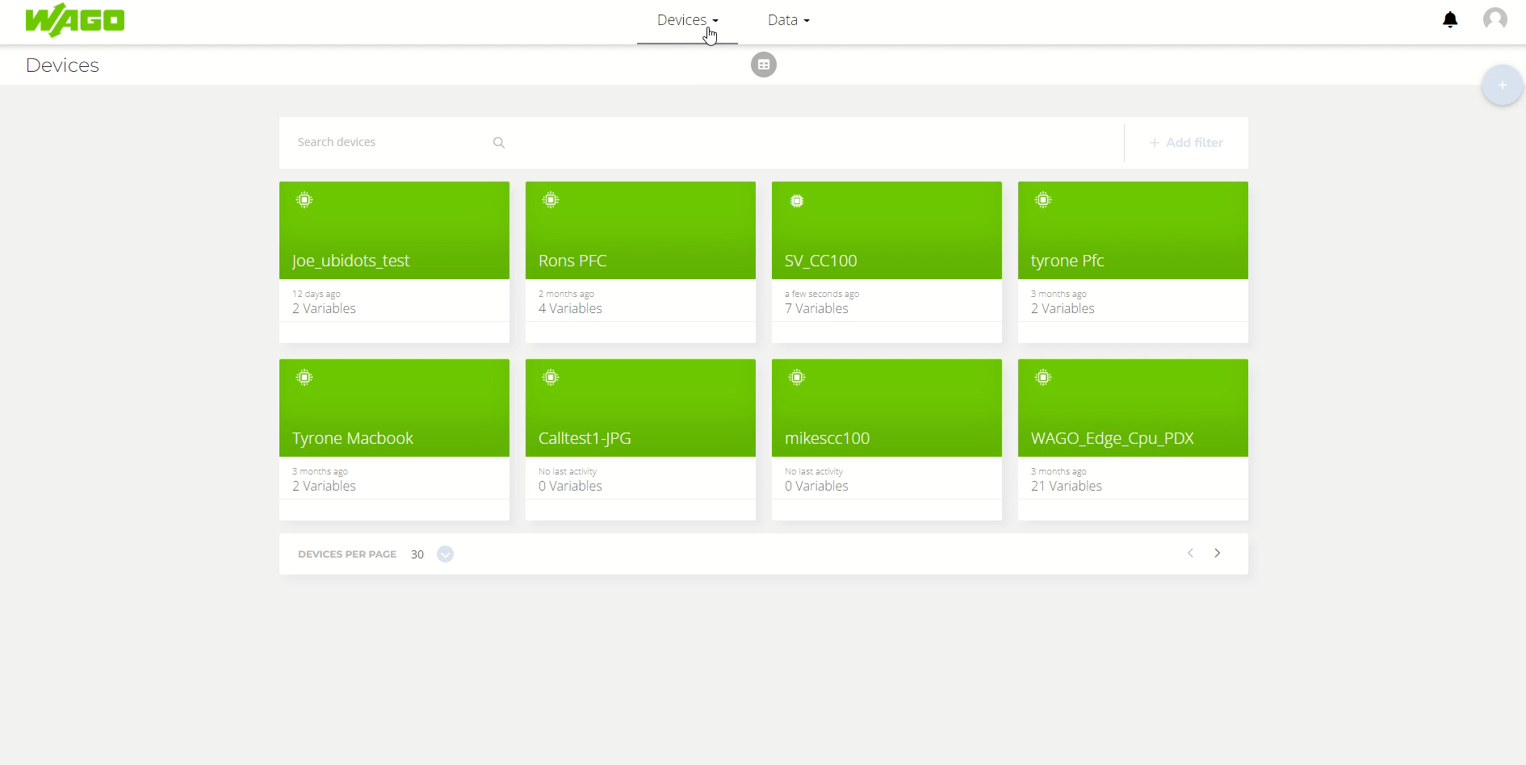
Ubidots Setup
1a) Login your Ubidots Account
1b)
Go to the ‘Devices’ tab on the top of the page, then click ‘devices’ in the drop-down.
Click the ‘+’ symbol on the top right corner of the screen.
Select ‘Blank device’
Create a device name and then you should see the new device pop up.
Video: Add device in Ubidots

Slide 3
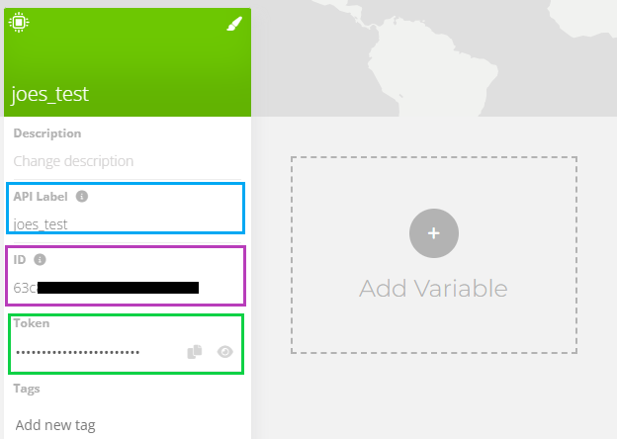
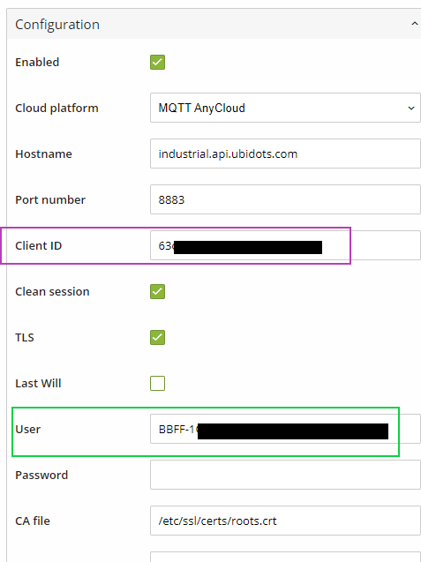
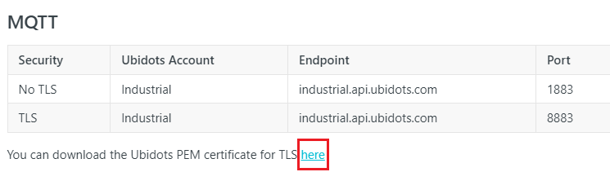
Ubidots Setup
1c)
Click on the newly created device and record the API Label, ID, and Token of the device.
You’ll need it for later.
1d)
You’ll need the Ubidots PEM certificate for TLS encryption to secure messages going to the cloud.
Found here:
https://docs.ubidots.com/v1.6/reference/broker-urls
Click on the link PEM cert download link then save the file as ‘roots.crt’

